Slide 1
DYNAMIC TRAFFIC MANAGEMENT AND OVERRIDE SYSTEM FOR EMERGENCY VEHICLES
​​
Akshin Anish 20220006
Anjali T 20220016
Hasin Javaid 20220043

Slide 2
CONTENTS
Introduction
Literature Survey
Existing system
Proposed system
Tools Used
Modular Design
Methodology
Sample Screenshots
Conclusion
Challenges
Future Scope

Slide 3
INTRODUCTION
Every year, people miss out on important events, get injured or even worse get killed due to traffic accidents. As the number of vehicles increases, traffic delays also impact a country's transportation sector. Current traffic management methods are inefficient due to their inability to adapt to varying traffic flow and the high cost of human intervention. Emergency vehicles, such as ambulances, face significant challenges in congested areas, leading to delays in reaching their destinations. To address these challenges, an automated and intelligent traffic management system is needed.

Slide 4
LITERATURE SURVEY
Title | Journal | Technique Used | Deliverables
1) Smart Traffic Lights Switching and Traffic Density Calculation using Video Processing Author: Anurag Kanungo, Ayush Sharma, Chetan Singla | Year of publication: 08 March, 2014 | Journal Article | Publisher: IEEE | Cameras would be capturing video and broadcasting it to the servers were using video and image processing techniques. | Should be installed with night vision cameras if we use dynamic system

Slide 5
LITERATURE SURVEY
Title | Journal | Technique Used | Deliverables
2) STLS: Smart Traffic Lights System for Emergency Response Vehicles Authors: Khalid M. Almuraykhi, Dr. Muhammad Akhlaq | Year of Publication: 2019 | Journal Article | Publisher: IEEE | The paper proposes a smart traffic lights system (STLS) that uses an Android app, MQTT (Message Queuing Telemetry Transport) protocol, Google maps, micro-controlled traffic lights and the Internet for connecting them together. | Expensive. Requires internet connectivity for functioning.

Slide 6
LITERATURE SURVEY
Title | Journal | Technique Used | Deliverables
3) Dynamic Local Vehicular Flow Optimization Using Real-Time Traffic Conditions at Multiple Road Intersections Authors: Sookyoung Lee; Mohamed Younis; Aiswarya Murali; Meejeong Lee | Year of Publication: 21 February 2019 | Journal Article | Publisher: IEEE | The paper have presented , a novel traffic flow control algorithm. In each intersection estimates the volume of incoming traffic and also analyzes the congested status of the next road segment for each flow of vehicles. | It allows more vehicles to pass through the road network and decreases their travel time by helping more vehicles move even under high traffic congestion. Our future work includes the extension of the proposed algorithm considering pedestrians.

Slide 7
LITERATURE SURVEY
Title | Journal | Technique Used | Deliverables
4) Traffic Flow Management of Autonomous Vehicles Using Deep Reinforcement Learning and Smart Rerouting Authors: Anum Mushtaq; Irfan Ul Haq; Muhammad Usman Imtiaz; Asifullah Khan; Omair Shafiq | Year of Publication: 02 March 2021| Journal Article | Publisher: IEEE | The paper has present a two-phased approach to control the traffic and avoid congestion in scenarios where all vehicles behave autonomously. In the first phase, it build a deep reinforcement learning-based intelligent traffic light module to optimize traffic flow during congestion. In the second phase of the approach, it proposed a smart rerouting technique that considers the congestion on the intersection by adjusting a thresh-hold limit and calculating travel times for each vehicle’s O-D matrix. | It is observed that traffic signals are using longer queue lengths and waiting times to adjust dynamically. In future, this approach can be extend to more complex road networks, with multiple signal intersections, and real-world road data set.

Slide 8
EXISTING SYSTEM
Current traffic management systems use either static methods or manual operation by police officers.
Inefficient
Labour Intensive
Hardware implementation
Not Scalable
Using police personnel to manage traffic manually.
Due to static time allocation the system has low efficiency.
For priority based systems, hardware implementation costs are expensive.
Inadequate software implementation hinders scalability and accessibility.

Slide 9
PROPOSED SYSTEM
The proposed system is a comprehensive model that utilizes advanced algorithms like YOLO, hardware components, and machine learning techniques for traffic optimization and emergency vehicle detection.
Our system is designed to offer the following features : -
Video Pre-processing
Identify Traffic Density
Dynamic Management
Emergency Override

Slide 10


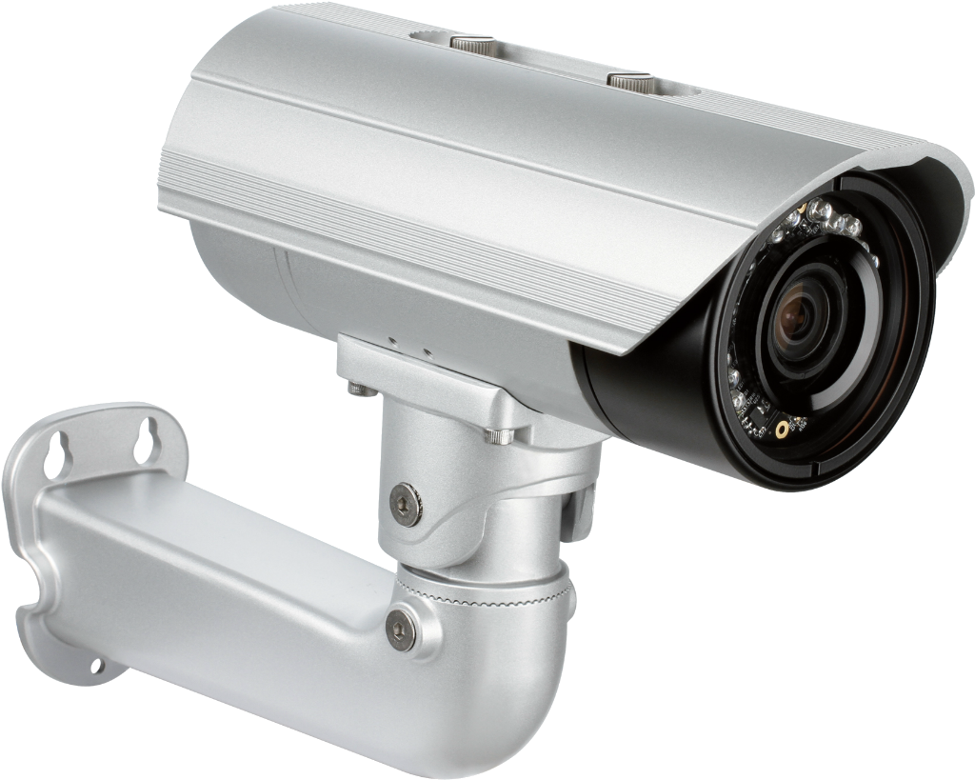
TOOLS USED
Python
Visual Studio
CCTV Cameras

Slide 11
MODULAR DESIGN
Video Stream Capture
Image Preprocessing
Frame Differencing and Background Subtraction
Vehicle Density Identification
Scheduling
Dynamic Green Signal Allotment
Has Emergency Vehicle ?
NO
YES
Override
Dynamic Green Signal Allotment

Slide 12
MODULE 1
We have used a highway traffic video as input here which is our data here.
So we need to install cameras at the traffic signals in order to capture the traffic video.
The images which we collect from sources like video input and camera needs to preprocessed as there are could be lot of noisy images in that dataset.
This can be done by following steps:
Grayscale Conversion
Masking
Contours
Area of Interest

Slide 13
MODULE 2
Traffic on each side of the road is calculated with the help of Image Processing techniques like :
Frame Differencing
Background Subtractor MOG2 Algorithm
In Background Subtractor MOG2 Algorithm , the objects which move can be foreground and the other part that remain static can be the background.
These values are maintained through “n” different threads for “n” roads in a junction for fast and efficient processing.
The calculated traffic from each side is compiled in the main thread and passed to the traffic management module.

Slide 14
MODULE 3
Depending on the traffic on each side of the road and taking into considering the fluctuations in traffic flow and rush hours during office hours, appropriate green-light time is calculated.
This amount of time is then allotted to the respective side while all other sides wait for their turn.
We use scheduling tables to perform scheduling of various lanes of the road.

Slide 15
MODULE 4
YOLO is used to identify the presence of emergency vehicles on any side of the road.
Upon detection of ambulance, the green signal goes to the lane where the vehicle was identified.
A static system is also added as backup, in case of any critical errors.

Slide 16
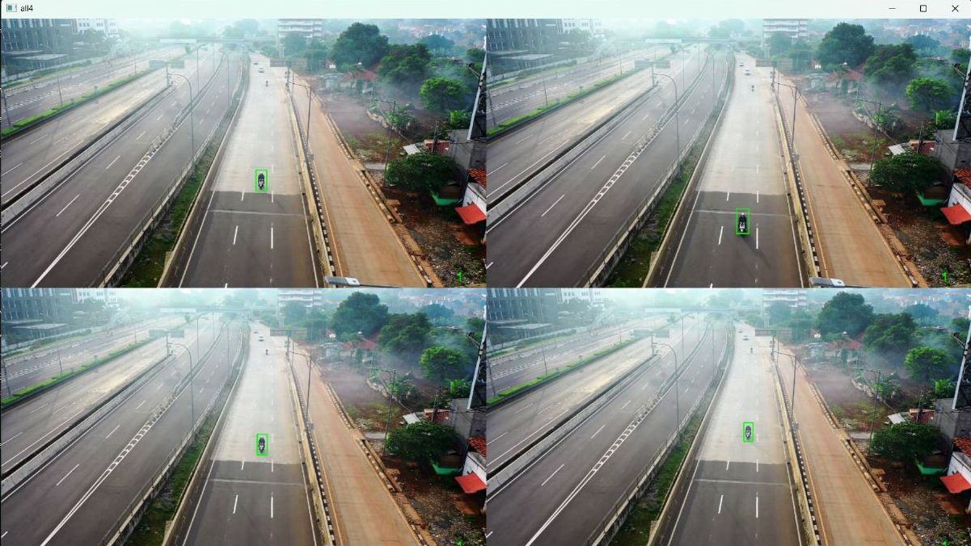
SAMPLE SCREENSHOTS - MOD 1 & 2

Slide 17
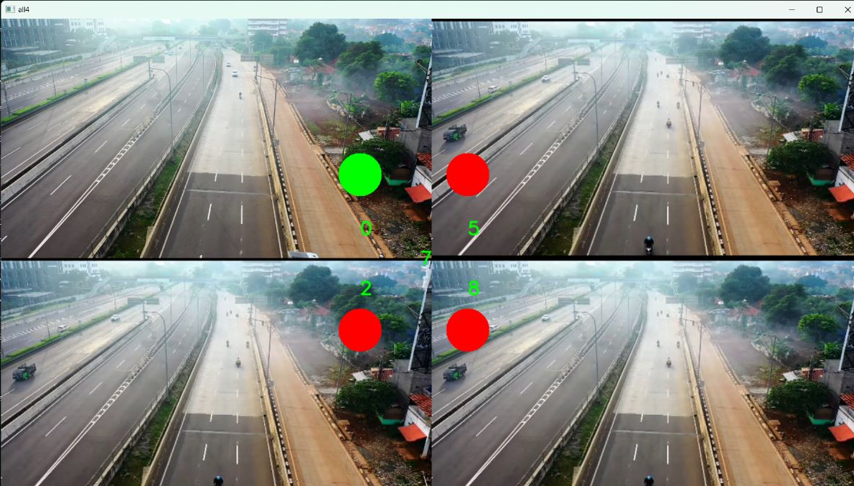
SAMPLE SCREENSHOTS - MOD 3

Slide 18
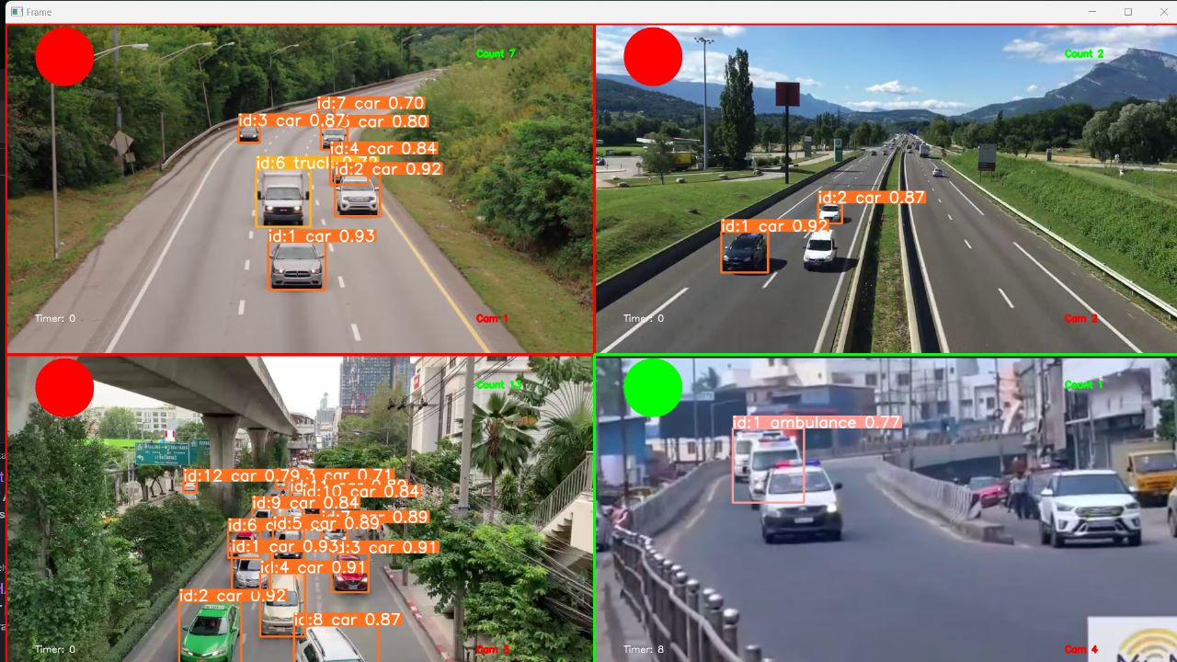
SAMPLE SCREENSHOTS - MOD 4

Slide 19
CONCLUSIONS
The system developed can effectively reduce traffic congestion in areas with high density of traffic. By avoiding unwanted waiting time and optimising the signal timing, people can commute faster. The override system that has been developed can prevent accidents occurring due to the abrupt crossing of red light by Ambulances, and also provide timely assistance in saving lives.

Slide 20
CHALLENGES
Camera Malfunctioning
Detecting Actual Emergency
Consideration of Traffic History
Large Datasets
Software Limitations
Extreme Weather Conditions

Slide 21
FUTURE SCOPE
1
Ensure pedestrian safety
2
Develop advanced algorithms for accurate ambulance detection.
3
Identifying accidents and taking necessary actions.
4
Multiple classes of emergency vehicles
5
Integration with smart navigation apps
6
Challan System

Slide 22
LIVE DEMO

Slide 23
THANK
YOU

